Slide 1
MS-700 macOS for Microsoft Teams!

Slide 2
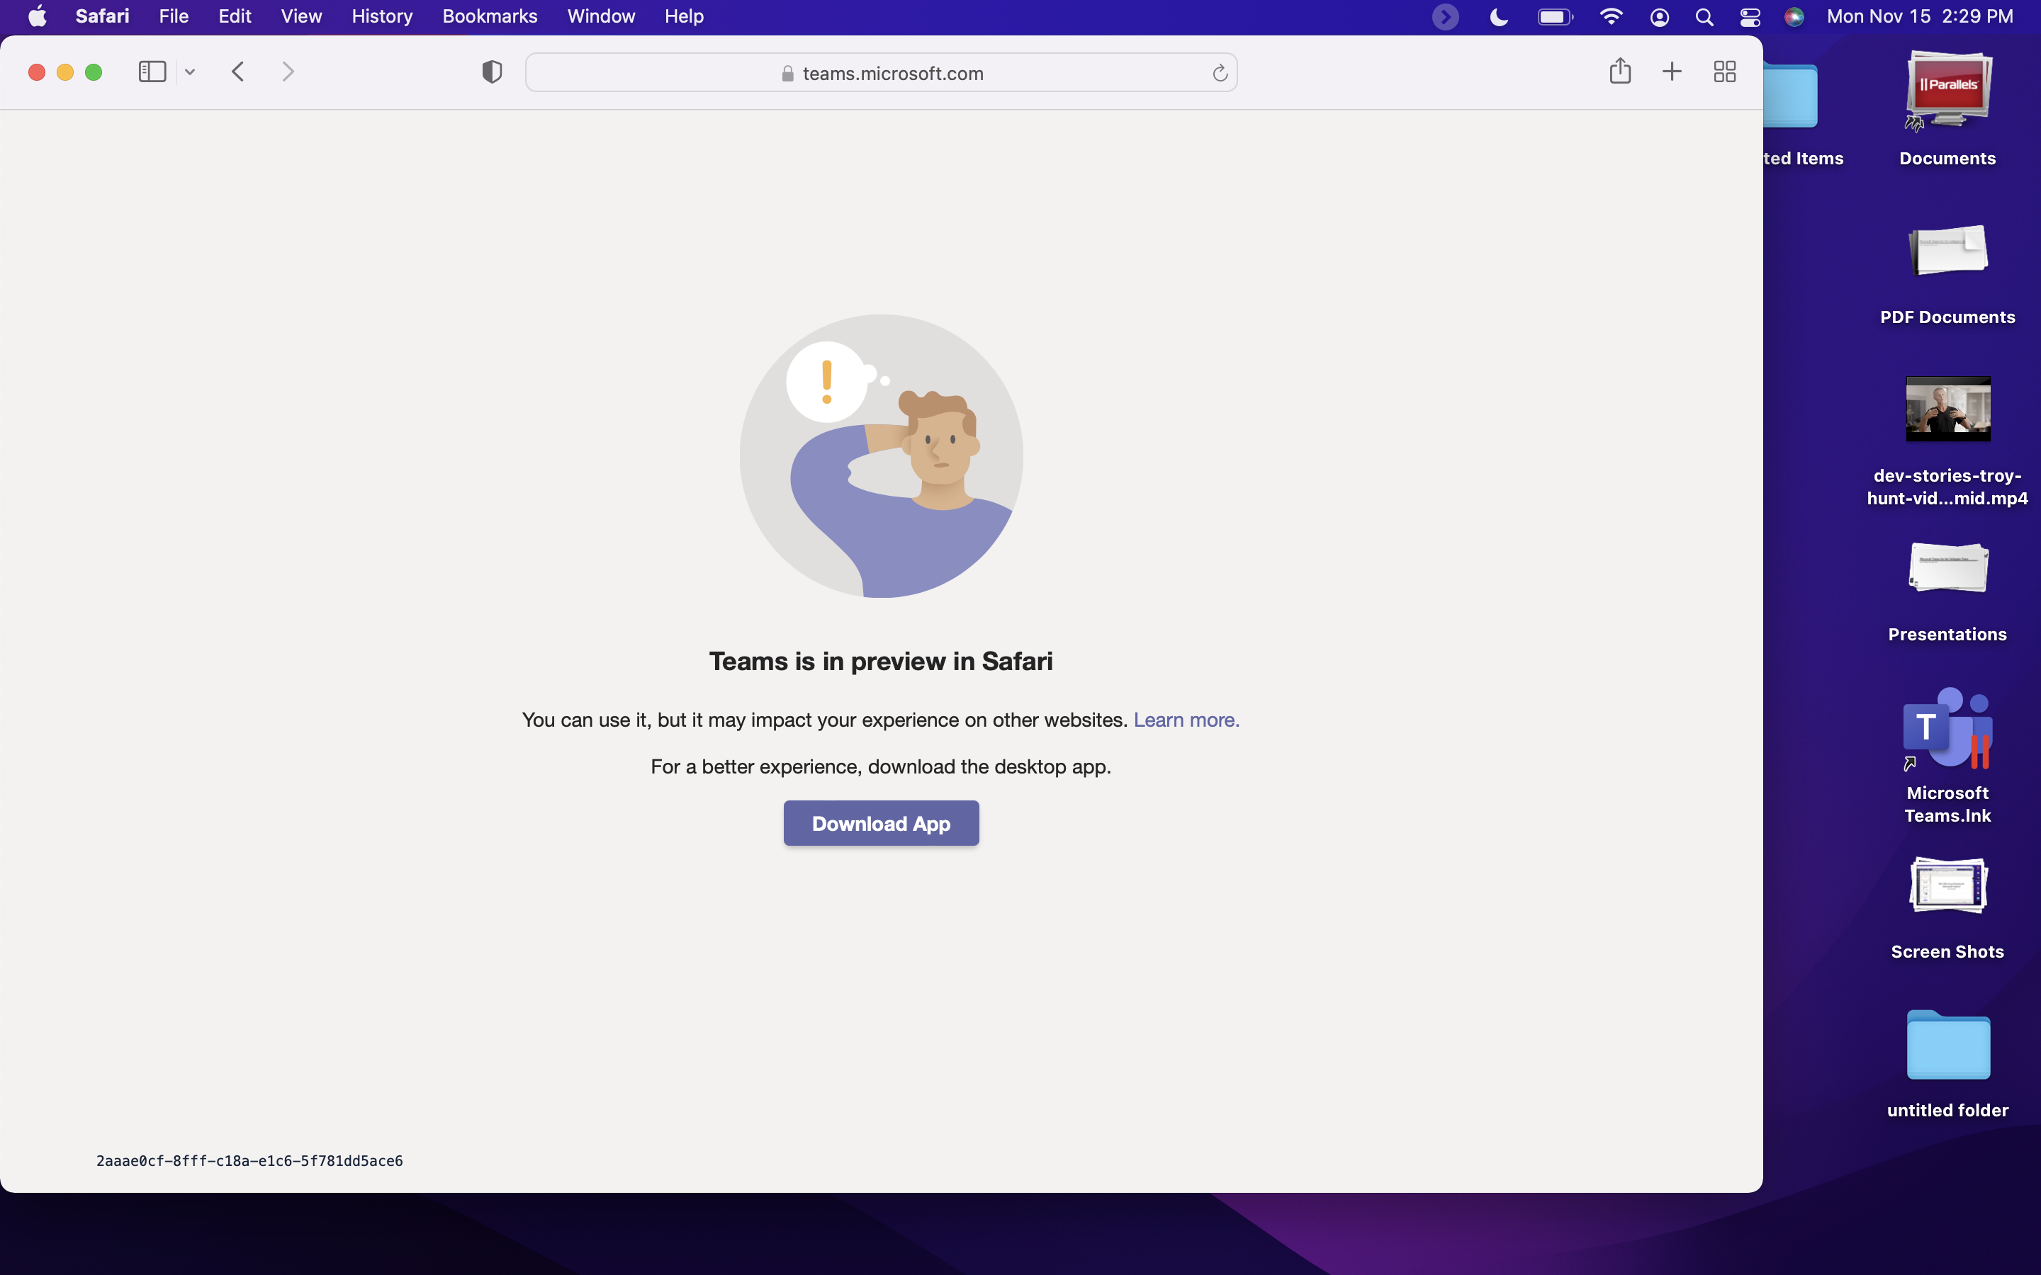
Safari support is in Preview (link now takes you to support article to enable cross site scripting)

Slide 3
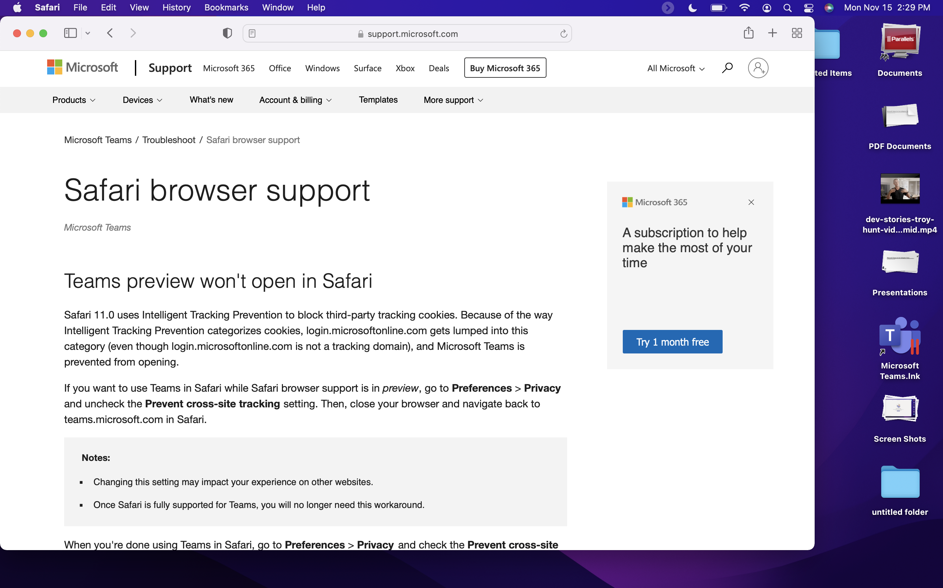
Preferences -> Privacy -> Prevent cross-site scripting (uncheck)

Slide 4
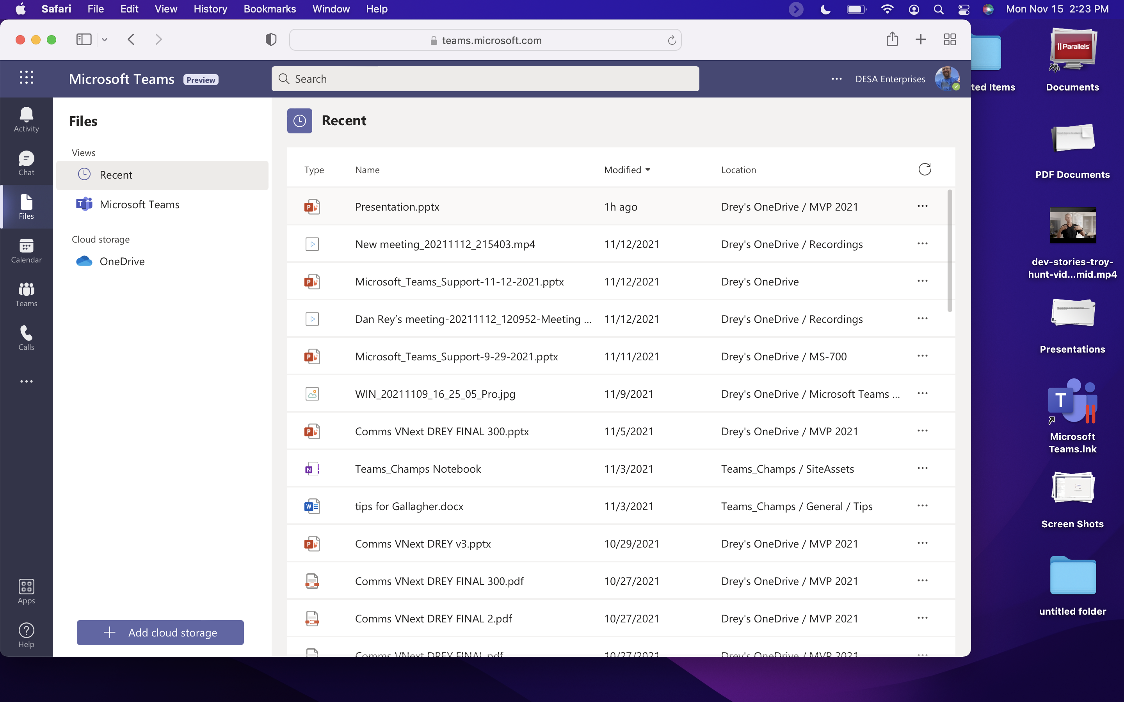
MS Teams on Safari Browser (macOS) Preview

Slide 5
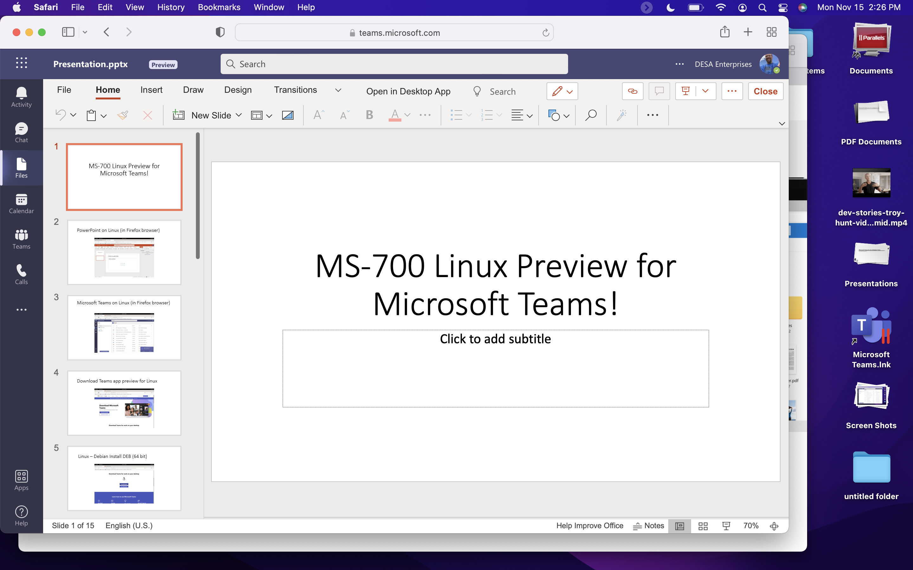
Functionality is pretty close at this point

Slide 6
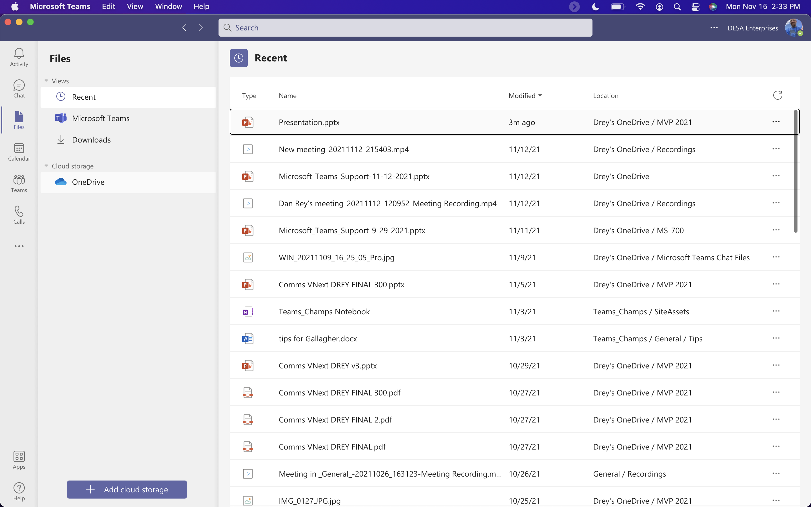
Teams app on macOS

Slide 7
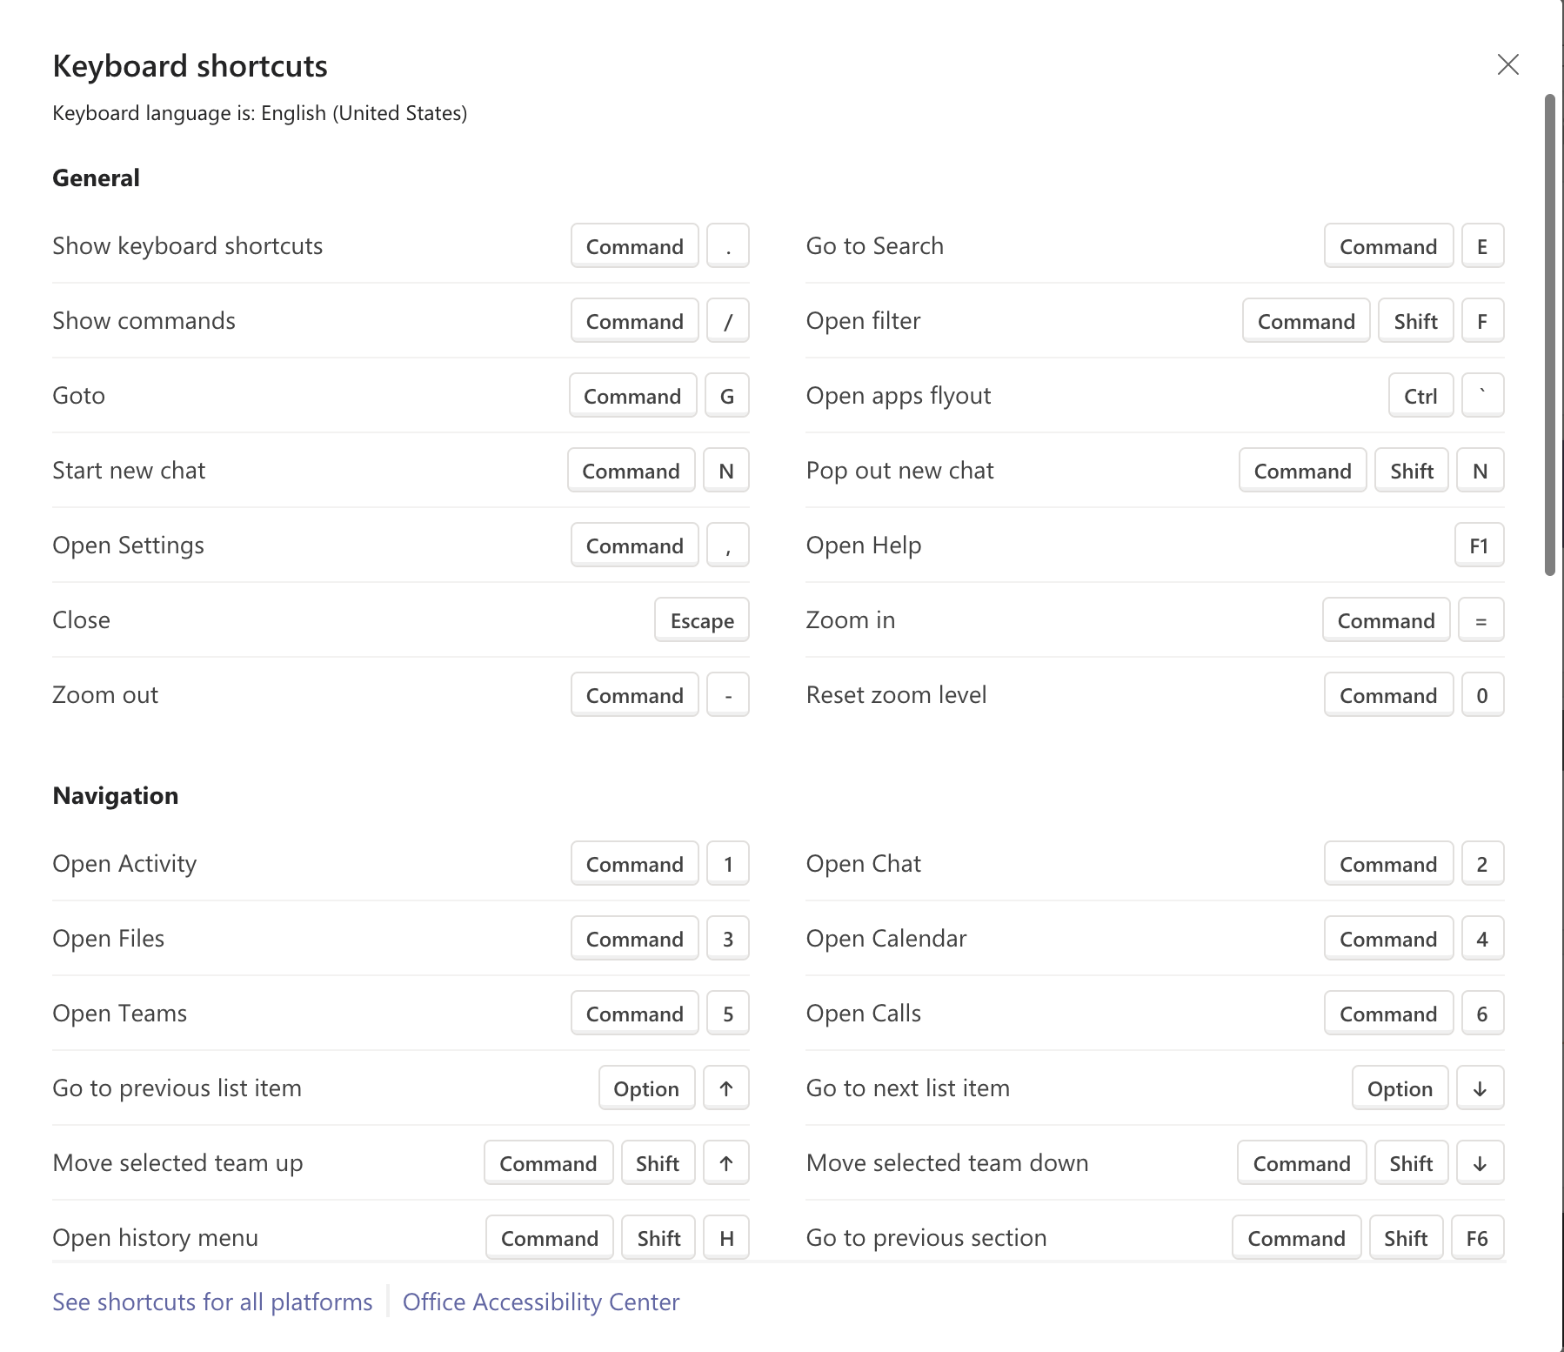
MacOS Keyboard Shortcuts

Slide 8
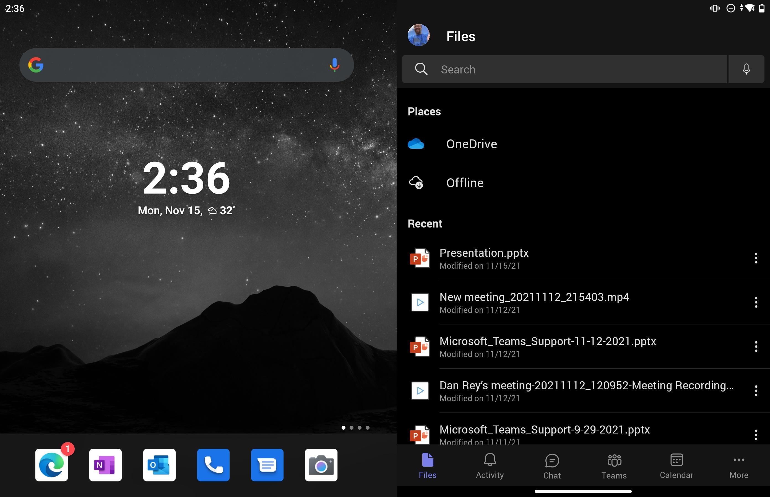
Surface Duo (Android OS - Dual Screen)

Slide 9
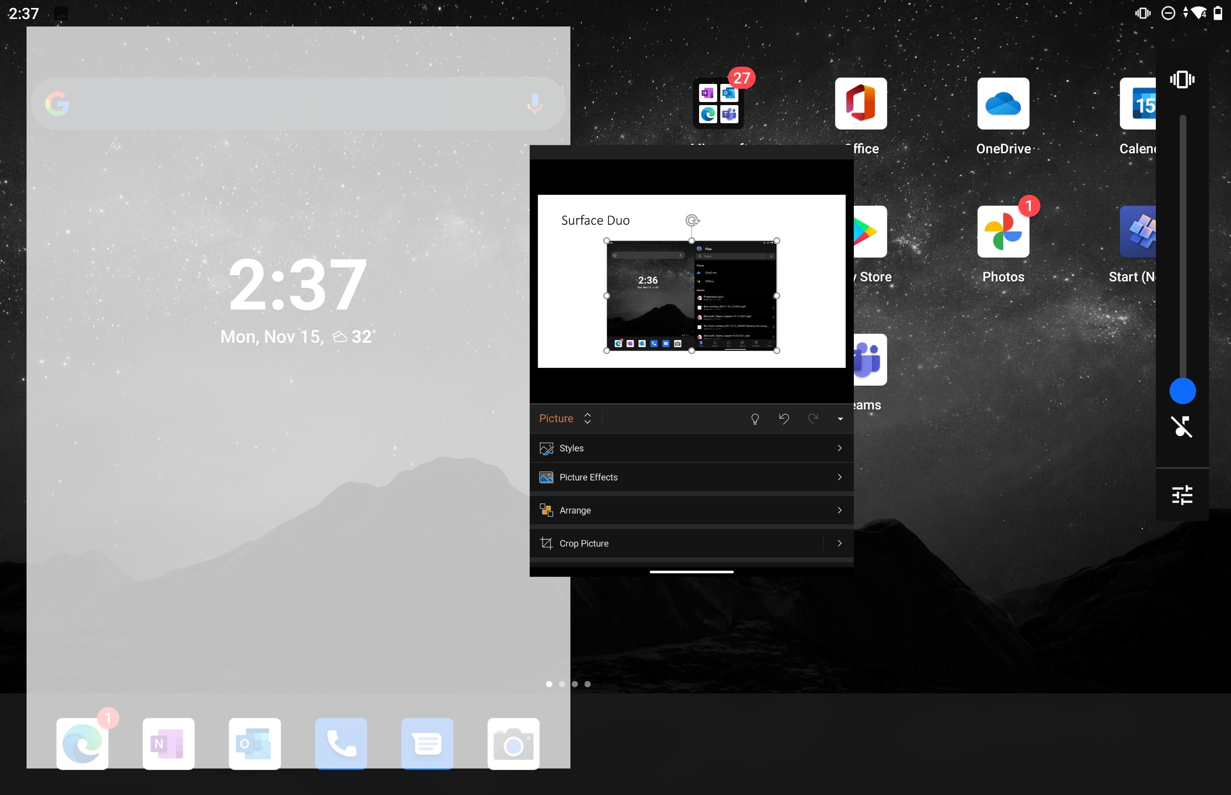
Teams can run on either side!

Slide 10
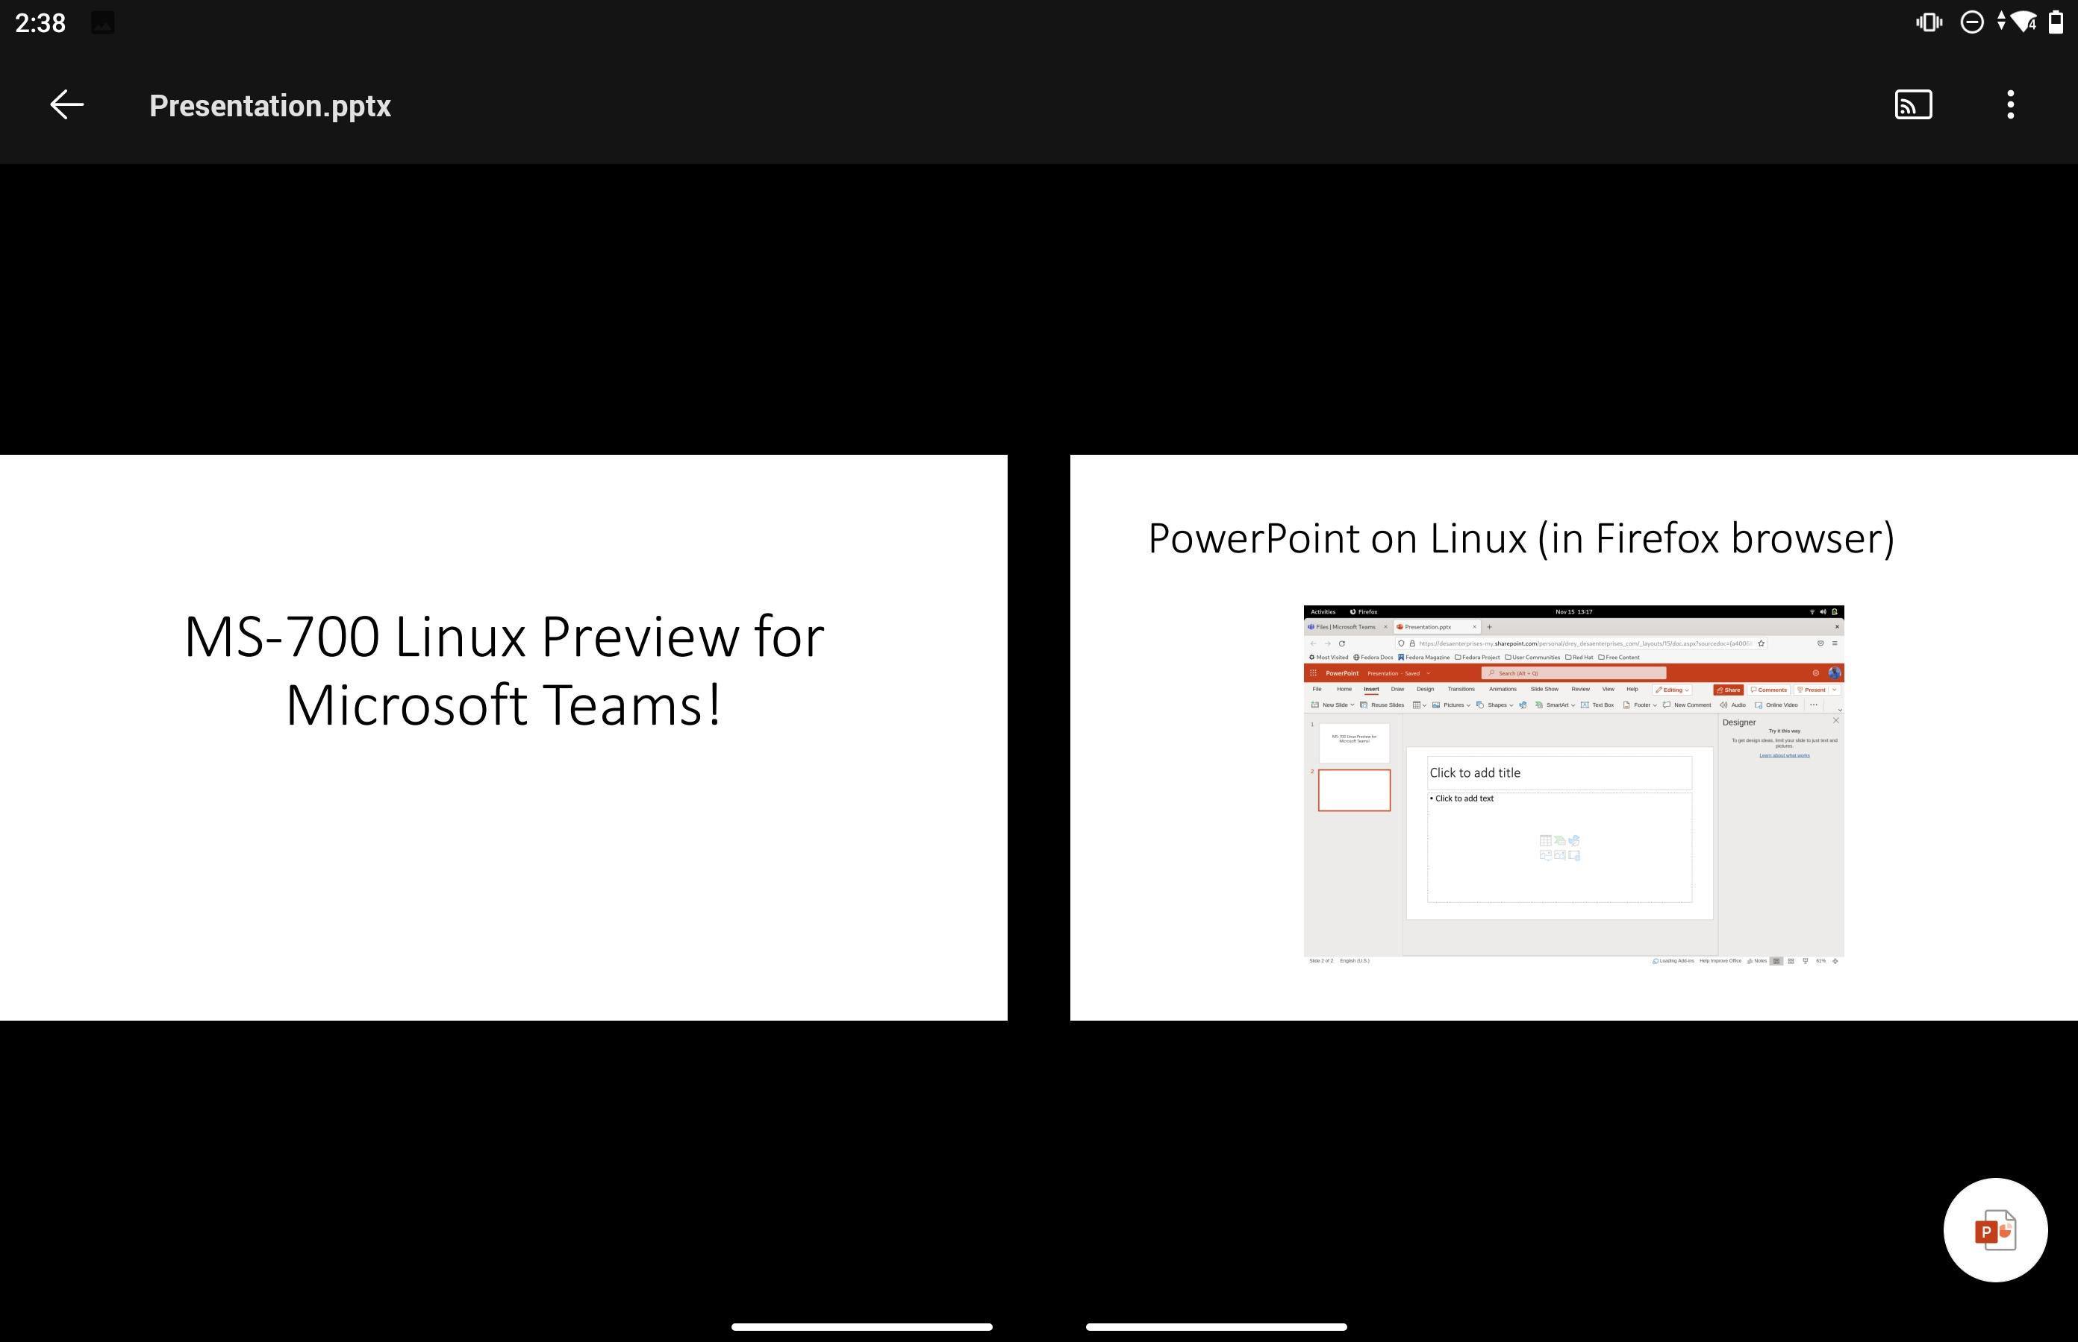
Teams can also span both screens!

Slide 11
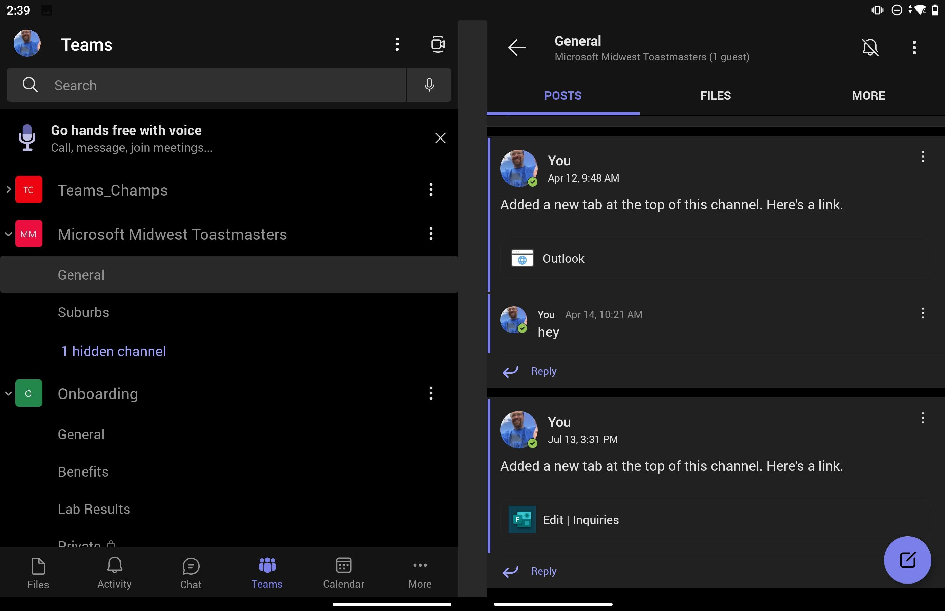
Teams Channel on left – channel details on right!

Slide 12
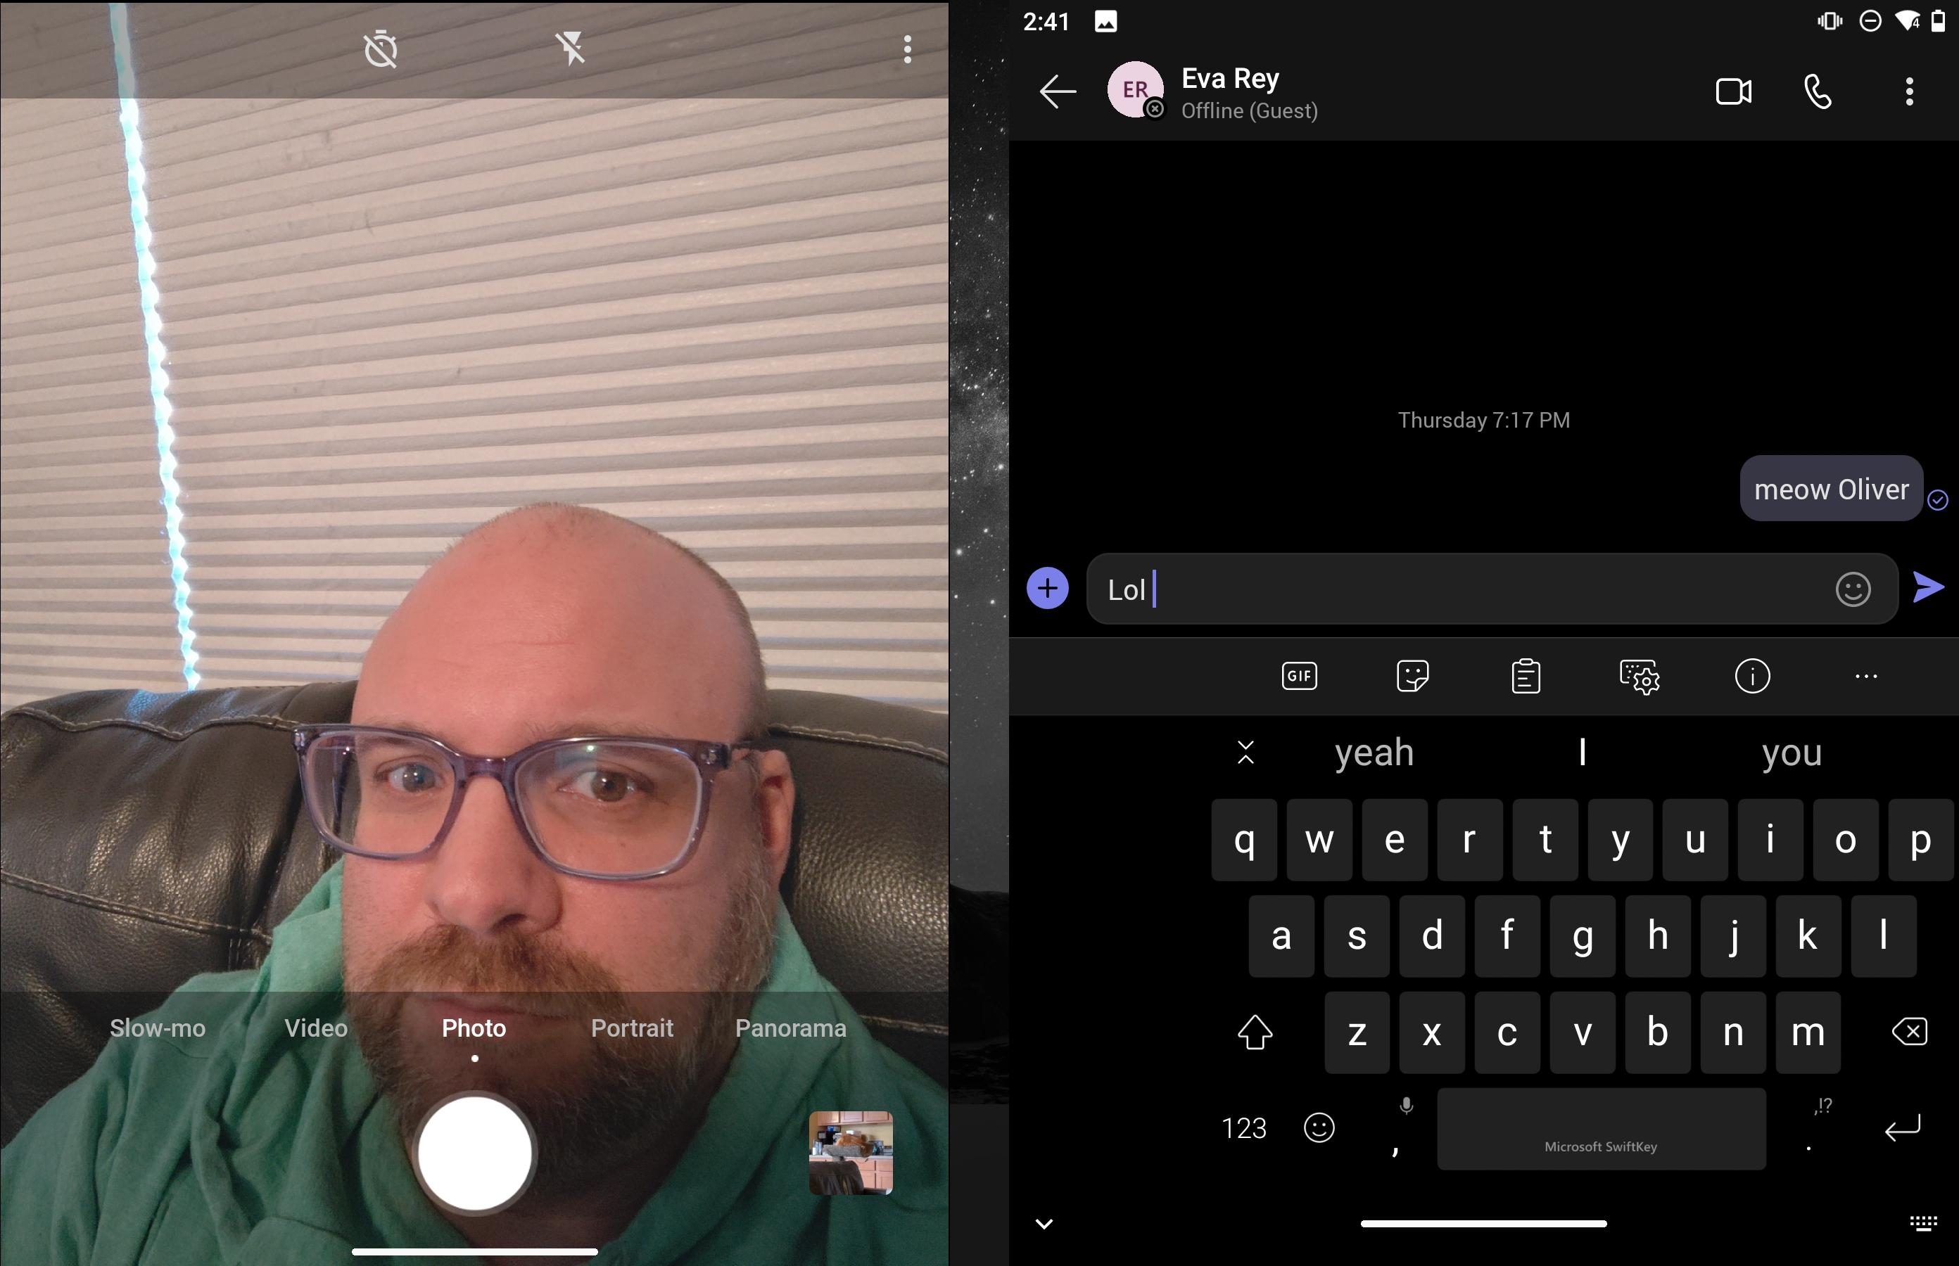
Camera and Teams

Slide 13

New Surface Duo 2 has dual cameras (one on either side) - original version only had 1 camera)

Slide 14
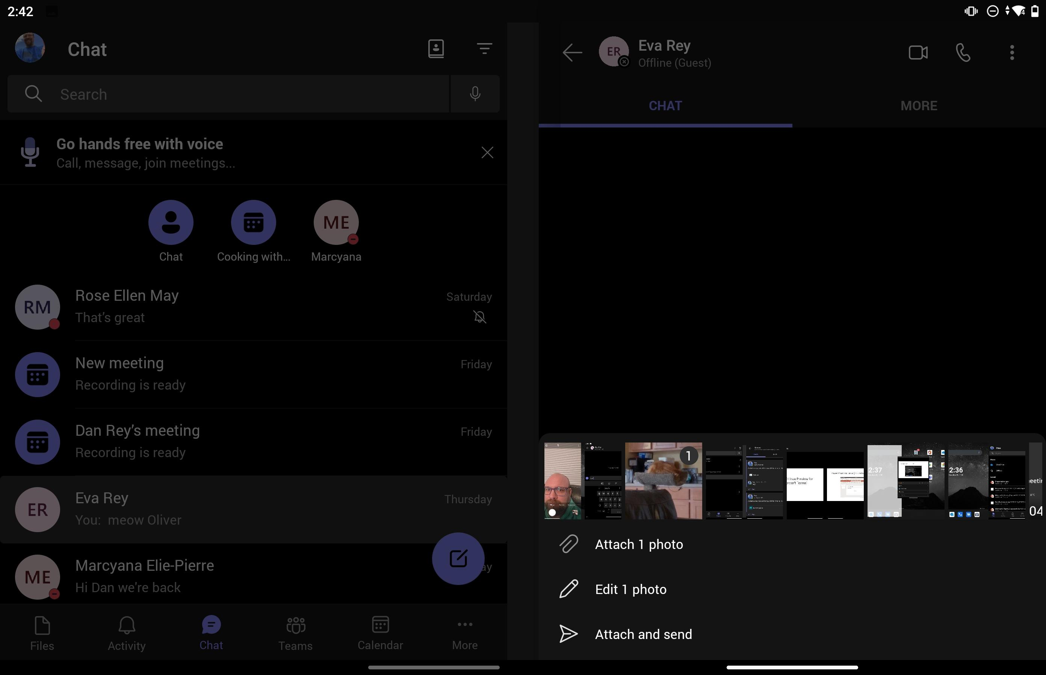
Teams Chat history on left – individual chat on right

Slide 15
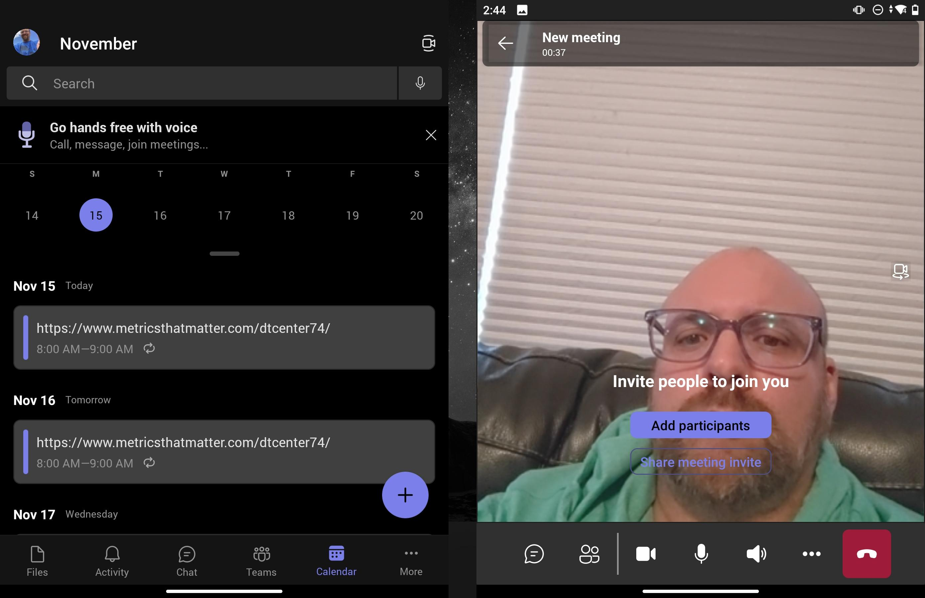
Teams Calendar on Left – Meeting on Right

